Slide 1
Nullness_Lite
An unsound option of the Nullness Checker with fewer false positives
Team Members:
Anny Kong(yk57), Spencer Huang(yh73), Alice Zhao(zhaox29), Cassie Chen(chenm32)
Notes:
We are the Nullness_Lite team. Out project is to create an unsound option for the Nullness Checker with fewer false positives.

Slide 2
Motivation
NullPointerException: the most frequent bug in Java Program [1]
Nullness Bug Detector: a huge convenience for developers
Notes:
NullPointerException is the most frequent error in Java.
Current Java’s type system is too weak to detect the nullness bugs at compile time.
Thus, a nullness bug detector provides a huge convenience for developers to fix the nullness bugs.

Slide 3
Related Works - NullAway
- Fast: the build time overhead of running NullAway < 10% [2]
- Easy to Use: plugin of ErrorProne which is widely used in industry
- Limitations: does not check code using generics and null assertions [3 & 4]
Notes:
added

Slide 4
Related Works - IntelliJ and Eclipse
- Statically checks errors when users type
- “Infer Nullity”: IntelliJ automatically introduces @Nullable and @NotNull to project

Slide 5
Related Works - FindBugs
- Uses heuristic pattern-matching to analyze
- Powerful: directly analyzes bytecode (does not need source code)

Slide 6
Related Works - The Nullness Checker
- A sound, pluggable type checker which aims to find all nullness bugs
(type-based dataflow analysis) [5]
- Ground truth of our evaluation due to its soundness
- Conservative: more false positives found [6]

Slide 7
Our Approach - The Nullness_Lite option
- Base: the Nullness Checker
- An unsound option with
Fewer annotations
Fewer false positives
- Provide an upgrade path for users to graduate to the full Nullness Checker
Notes:
For our project, we choose the Nullness Checker to be our base project, because the Nullness Checker is sound;
There is a design space for users to deal with fewer

Slide 8
Implementation
By disabling suggested* features in the Nullness Checker, the Nullness_Lite option assumes
All variables are initialized**
Map.get(key) returns @NonNull**
No aliasing and all methods are @SideEffectFree**
BoxedClass.valueOf() are @Pure**
* ideas listed in the Nullness bug detector section of GSoC ideas 2018 [7]
** Refer to our report for details
Notes:
Considering the suggestions listed in the Nullness bug detector section of GSoC ideas 2018 [22]

Slide 9
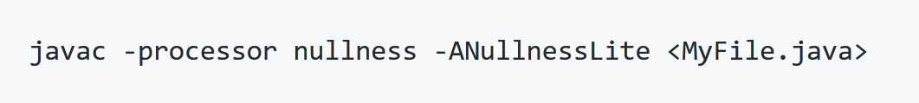
Command_Line Interface
Notes:
ANullnessLite is the Nullness Checker specific option

Slide 10
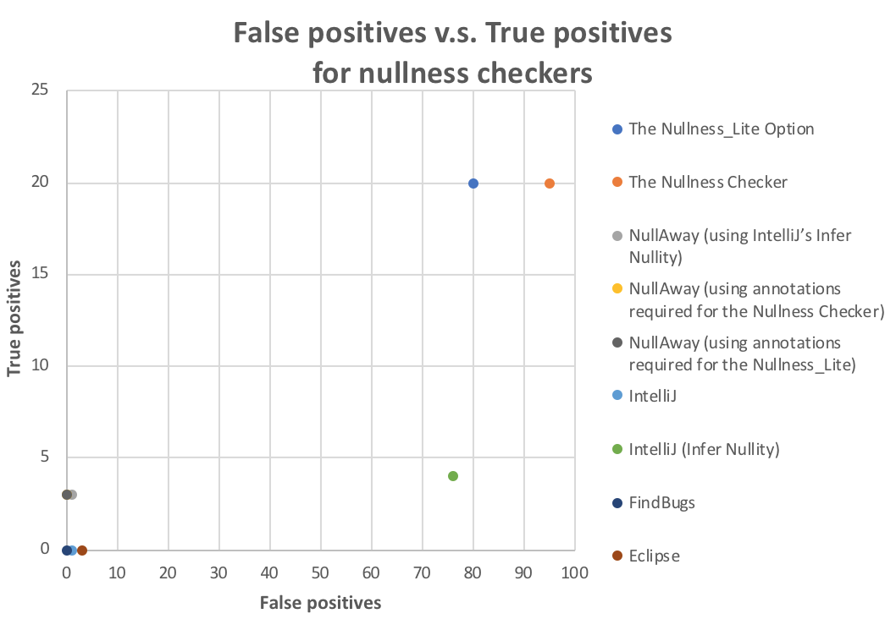

Slide 11
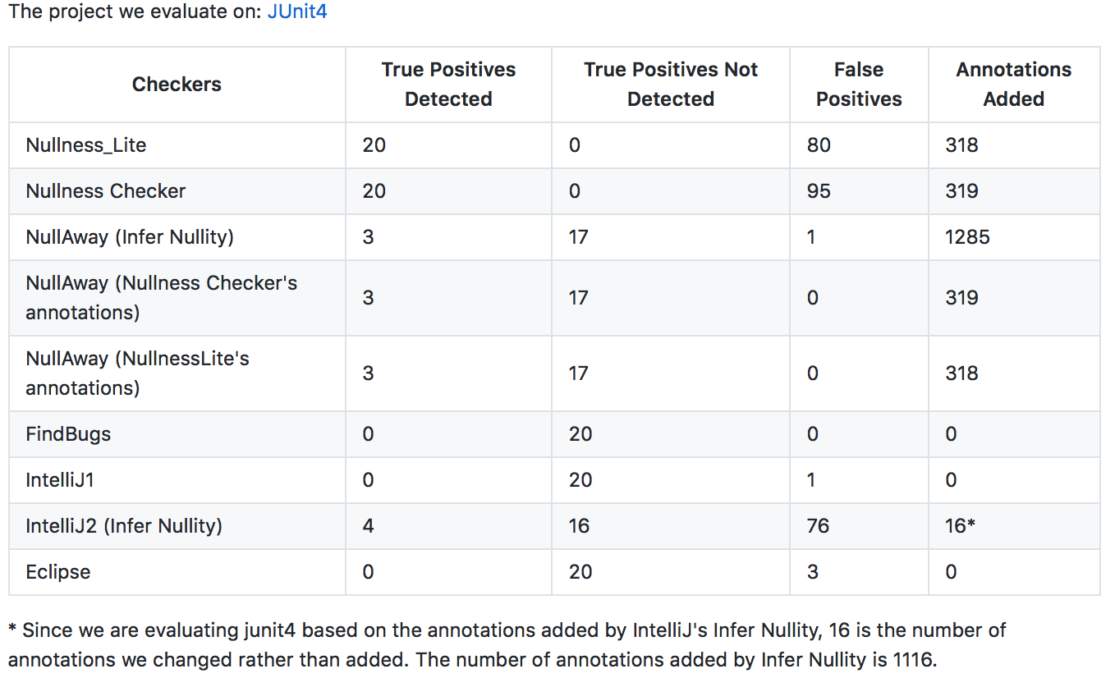
Evaluation Result
Notes:
For our evaluation, we compare the Nullness_Lite with all nullness bug detectors we mentioned before. As we can see from the table, the Nullness_Lite option reduced 15 more false positives than the Nullness Checker and still detected all 20 true positives in JUnit4, which means the Nullness_Lite option works well in JUnit4 but it does not imply the performance on other projects. We evaluate the Nullness_Lite option in following three steps.

Slide 12
Evaluation Methodology for JUnit4
For the Nullness_Lite option and the Nullness Checker, we add annotations manually to reduce false positives.
An error is an true positive if
the JUnit4 API provides users with functions to raise NPEs
the internal implementation raises NPEs
An error is an false positive otherwise
Notes:
Other checkers don’t require adding annotations manually.

Slide 13
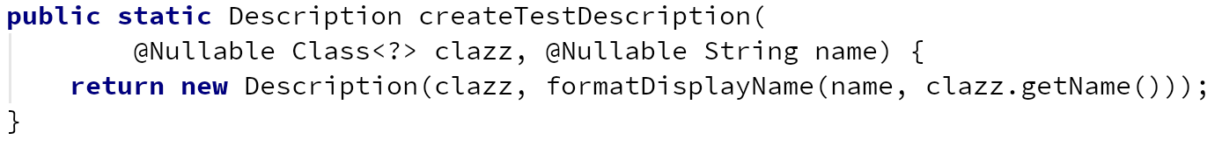
Analysis Examples in JUnit4 - True Positive
The example above is cited from
src/main/java/org/junit/runner/Description.java
*Refer to our report and repository for details and more true positive examples.

Slide 14
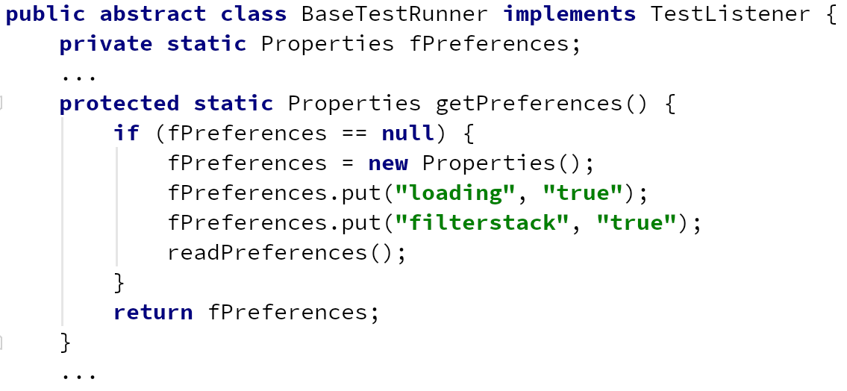
Analysis Examples in JUnit4 - False Positive
The example above is cited from
src/main/java/junit/runner/BaseTestRunner.java
*Refer to our report and repository for details and more false positive examples.

Slide 15
Lessons learned & Future Work
Analyze other features in the Nullness Checker to see whether it is possible to further reduce false positives
We can extend our evaluation on these checkers by analysing on more larger, well maintained projects.

Slide 16
Thank you !
Works Cited:
Maciej Cielecki, Je ̧drzej Fulara, Krzysztof Jakubczyk, and Jancewicz. Propagation of JML non-null annotations in java programs. In Principles and practice of programming in Java, pages 135–140, 2006.
Uber. “Uber/NullAway.” GitHub, github.com/uber/NullAway.
Sridharan, Manu. “Support Models of Generic Types · Issue #54.” GitHub, Uber/NullAway, 6 Nov. 2017, github.com/uber/NullAway/issues/54.
kevinzetterstrom. “Support for null assertions · Issue #122 · Uber/NullAway.” GitHub, github.com/uber/NullAway/issues/122.
Dietl, Werner, et al. “Building and Using Pluggable Type-Checkers.” Proceeding of the 33rd International Conference on Software Engineering - ICSE '11, 2011, doi:10.1145/1985793.1985889
Dietl, Werner, and Michael Ernst. “ Preventing Errors Before They Happen The Checker Framework.” Preventing Errors Before They Happen The Checker Framework, www.google.com/url?sa=t&rct=j&q=&esrc=s&source=web&cd=7&cad=rja&uact=8&ved=0ahUKEwiup6_V5bPaAhXKrFQKHWgCxYQFghaMAY&url=https%3A%2F%2Fstatic.rainfocus.com%2Foracle%2Foow17%2Fsess%2F1492901668615001brln%2FPF%2F2017-10-02%2520CF%2520%40%2520JavaOne_1507012791774001WJ2t.pdf&usg=AOvVaw3mAtzExTzYm6gr3sCn0cXb.
“GSoC Ideas 2018.” Checker Framework Organization: GSoC Ideas 2018, rawgit.com/typetools/checker-framework/master/docs/developer/gsoc-ideas.html.
https://github.com/weifanjiang/Nullness_Lite/blob/master/reports/week10/Report-10.pdf

